Slide 1


Maximum Likelihood Estimation (MLE)
Notes:
In this presentation we discuss Maximum Likelihood Estimation or MLE method. MLE has wide applications in statistical modeling and particularly for optimizing classification models such as Logistic Regression models which we will consider later on.

Slide 2
The Setting
We have a probabilistic model, M, of some phenomena. We know exactly the structure of M, but not the values of its probabilistic parameters, Θ.
Each “execution” of M produces an observation, x[i] , according to the (unknown) distribution induced by M.
Goal: After observing x[1] ,…, x[n] , estimate the model parameters, Θ, that generated the observed data.
Notes:
So here is the setting; let’s assume that we have a probabilistic model of a phenomenon called M. Let’s say that we know the structure and formulation of M, but we do not know the value of the parameters of the value of the model, which is theta. Each execution of M can produce observations x[i] according to a given distribution that is induced by M. Now, after seeing a number of observations, the objective is to estimate the model parameters theta that generated the observed data. Now, after seeing a number of observations, the objective is to estimate the model parameter theta, that generated the observed data.

Slide 3
Maximum Likelihood Estimation (MLE)
The likelihood of the observed data, given the model parameters Θ, is the conditional probability that the model, M, with parameters Θ, produces x[1] ,…, x[n] .
L(Θ)=Pr(x[1] ,…, x[n] | Θ, M),
In fact, the likelihood function is proportional to the probability of observing the data given a specified parameter value
One natural choice for point estimation of parameters is the Maximum Likelihood Estimate (MLE), which seek to find the parameter values, Θ, that maximise the probability of observing the data
Notes:
The likelihood of the observed data can be defined as the conditional probability that the model M, with the parameter theta produces the series of the observations. In fact, the likelihood function is proportional to the probability of observing the data given a specific parameter value theta in this case. Now, the natural choice for point estimate of parameters is the maximum likelihood estimation or MLE framework, which seek to find the parameter values theta that can result in maximizing the probability of observing the data. In other words, we are looking for theta values that makes the model such that it has the highest probability of generating the underlying data that has been observed.

Slide 4
Maximum Likelihood Estimation (MLE)
The MLE principle is applicable in a wide variety of applications, from speech recognition, through natural language processing, to computational biology.
We will start with the simplest example to explain the concept: estimating the bias of a coin.
Notes:
The MLE principles and framework is widely applied in a variety of applications from speech recognition to natural language processing to computational biology. It also forms the principals of classification algorithms such as logistic regression that we will consider later on. The following slide we will use the simple example to explain the concept of MLE and how it works.

Slide 5
Example: Binomial Experiment
We now consider an example of tossing a coin. When a coin is tossed, it can land in one of two positions: Head (H) or Tail (T)
We denote by θ the (unknown) probability P(H).
Task: given a sequence of toss samples x[1], x[2], …, x[n] we want to estimate the probabilities P(H)= θ and P(T) = 1 - θ
Notes:
We now consider an example of tossing a coin. When a coin is tossed it can land in two positions, heads or tails. Label the probability of heads as P(H). Our task here is to look at the series of outcomes x[1] to x[n] and estimate the probability of heads that is theta or the probability of tails that is one minus theta.

Slide 6
Example: Binomial Experiment
How good is a particular θ? It depends on how likely it is to generate the observed data
The likelihood for the sequence H,T, T, H, H is
Notes:
Now let’s see how we can evaluate to see how good a particular value of theta is. The fitness of the value of theta depends on how likely it is to generate the observed data. In other words, it is proportional to the conditional probability that we can generate the same data given the parameter theta. More specifically, for a given sequence of observations D, the likelihood of theta can be defined as the conditional probability of observing D given theta. In our previous example, let’s assume that the sequence of observed data was head, tail, tail, head, and head. So we have five observations in here. So, we know that theta is the observation of head. So, the probability of observing this sequence of data would be theta multiplied by one minus theta, which is associated to saying the second tail multiplied by one minus theta which is associated to observing the third tail multiplied by theta which is associated to observing the fourth observation which is head and again multiplied by theta for the last head.

Slide 7
Example: Binomial Experiment
To compute the likelihood in the previous example we only require N_{H} and N_{T} (the number of heads and the number of tails)
MLE Principle: Choose parameters that maximize the likelihood function. This is one of the most commonly used estimators in statistics
Notes:
If you look closely in the previous example, to compute the likelihood, all we will require is the number of heads and the number of tails. If we show the number of tails with NT and the number of heads with NH, we can write the likelihood formula as LD of theta is equal to theta power NH multiplied by one minus theta power NT. Within the MLE framework, what we try to do is choose the parameter theta such that to maximize the likelihood function. Note that this is one of the most common use estimators in the field of statistics.

Slide 8
Example: Binomial Experiment
One usually maximizes the log-likelihood function, defined as l_{D}(θ) = ln L_{D}(θ)
Taking derivative and equating it to 0, we get
Notes:
In practice it is very common to maximize the log-likelihood function instead of the function itself. So, the logarithm of the likelihood function can be written as LD of theta equal to NH multiplied by the log of theta plus NT multiplied by log of one minus theta. Note that the logarithmic function is a monitoring function. Therefore, the value of theta that maximizes the likelihood would be the same value that maximizes the log of the function as well. In order to calculate the theta value that maximizes the likelihood, we can take the derivative and equate that to zero. By doing that, we have NH divided by theta equal to NT divided by one minus theta, which means that the theta hat, or the optimal value of theta, would be NH divided by NH plus NT. That makes sense because what the formula is telling us is that the optimal value of theta is the number of heads divided by the number of trials. And this can be easily associated to the optimal value for selecting the probability of heads.

Slide 9
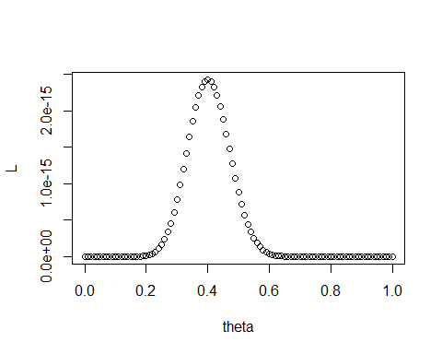
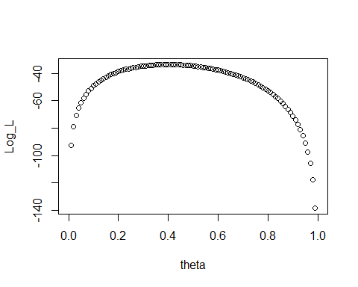
Example: Binomial Experiment
# Lets consider an example # Suppose we had 20 heads out of 50 tries theta=seq(0,1, by=0.01) N_H=20 N_T=30 L=theta^N_H*(1-theta)^N_T Log_L=log(theta^N_H*(1-theta)^N_T) plot(theta,L)
Notes:
Here is the visualization of the example we just considered. For this case we define a range of theta values starting from zero to one. Also, we define the number of heads as 20 and the number of tails as 30. The likelihood function itself can be defined as theta, power NH multiplied by one minus theta power NT. We also define the logarithm of the likelihood function as well. On the right hand-side we can see the plots of the likelihood function against theta and also the plot of the log of the likelihood function against theta. As we can see, both functions are maximized at 0.4 and 0.4 seems to be the value of theta that maximizes the likelihood. If we look back at the formula, the formula was suggesting that the optimal value of theta would be NH divided by NH plus NT. In this case, NH is 20, so 20 divided by 20 plus 30 would be 20 divided by 50, which would be 0.4. Also, as we can see, finding the value of theta that maximizes the likelihood itself, is the same as finding the theta value that maximizes the log of the likelihood value as we were expecting.

